Slide 1



Interaction in Progressive Visual Analytics
Application to progressive sequential pattern mining
PhD defense
Vincent Raveneau
Advisors: Yannick Prié, Julien Blanchard
November 4th, 2020

Slide 2



Log analysis
1.1 – Context of the PhD thesis
2 – Related Works
3 – Propositions
4 – Conclusion
?
?
?
10:00 – Login
10:01 – Open directory
10:04 – Open file
10:05 – Save file
...
...
Trace

Slide 3

Pattern Mining
1.1 – Context of the PhD thesis
2 – Related Works
3 – Propositions
4 – Conclusion
...
Pattern Mining algorithm
login, logout
playVideo, pause
createComment, postComment, playVideo
…
Exploration
Data
Knowledge

Slide 4
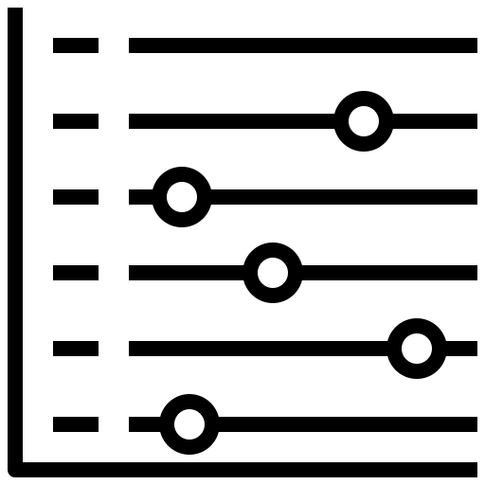

Visual Analytics
1.1 – Context of the PhD thesis
2 – Related Works
3 – Propositions
4 – Conclusion
Pattern Mining algorithm
...
Exploration
Visualization computation
Data
Knowledge
Visual Analytics System

Slide 5
Progressive Visual Analytics
1.1 – Context of the PhD thesis
2 – Related Works
3 – Propositions
4 – Conclusion
Progressive Pattern Mining algorithm
...
Exploration
Progressive Visualization computation
Data
Knowledge
Progressive Visual Analytics System

Slide 6
Focuses and contributions
1.2 – Contributions
2 – Related Works
3 – Propositions
4 – Conclusion
Interaction in Progressive Visual Analytics
A clarification of the interaction process
An updated definition of Progressive Visual Analytics
Interaction with a Pattern Mining Algorithm
Progressive Pattern Mining algorithm
Progressive Pattern Mining algorithm
A data and task model for an analyst exploring temporal data with patterns
Five guidelines for the design of a progressive algorithm for pattern mining in sequences
Progressive Visualization computation
Progressive Visualization computation
Implementation of a Progressive Pattern Mining system
PPMT, a progressive pattern mining system
A user experiment focused on the impact of the interactions between the analyst and the algorithm on a progressive analysis process

Slide 7
Outline
Related works
  From Visual Analytics to Progressive Visual Analytics
  Interaction in Progressive Visual Analytics
  Sequential Pattern Mining and Progressive Visual Analytics
Contributions
  Clarifying interaction in Progressive Visual Analytics
  Implementing Progressive Pattern Mining
  Evaluating the impact of progressiveness on analysis tasks
Conclusion and Discussion

Slide 8
Outline
Related works
  From Visual Analytics to Progressive Visual Analytics
  Interaction in Progressive Visual Analytics
  Sequential Pattern Mining and Progressive Visual Analytics
Contributions
  Clarifying interaction in Progressive Visual Analytics
  Implementing Progressive Pattern Mining
  Evaluating the impact of progressiveness on analysis tasks
Conclusion and Discussion

Slide 9
From Visual Analytics…
1 – Introduction
2.1 – From Visual Analytics to Progressive Visual Analytics
3 – Propositions
4 – Conclusion
Select Dataset
Select Analytics Parameters
Run Analytics
Wait for Analytics to Complete
Visualize Results
Interpret Results
Illustration from Stolper et al., 2014

Slide 10
… to Progressive Visual Analytics
1 – Introduction
2.1 – From Visual Analytics to Progressive Visual Analytics
3 – Propositions
4 – Conclusion
Select Dataset
Select Analytics Parameters
Run Analytics
Wait for Analytics to Complete
Visualize Results
Interpret Results
Visualize Partial Results
Select Dataset
Select Analytics Parameters
Run Analytics
Visualize Results
Interpret Results
Interpret Partial Results
Illustration from Stolper et al., 2014

Slide 11
Definition and features of Progressive Visual Analytics
1 – Introduction
2.1 – From Visual Analytics to Progressive Visual Analytics
3 – Propositions
4 – Conclusion
« methods to avoid [...] speed bumps, where analysts can begin making decisions immediately [by] visualizing partial results [that] provide early, meaningful clues [...] without waiting for long-running analytics to terminate »
Stolper et al., 2014
Meaningful partial results
Visual interfaces to manage the partial results
Ability to control and interact with the ongoing computation

Slide 12
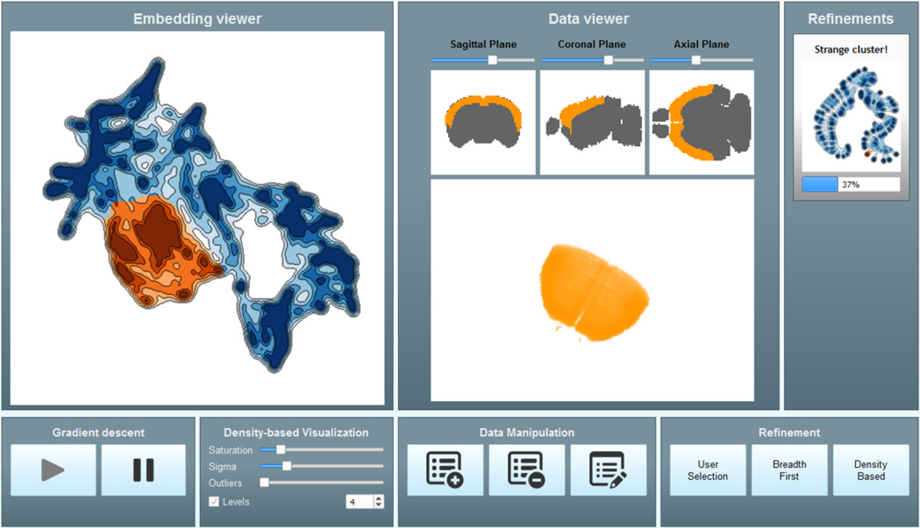
Approximated tSNE (Pezzotti et al., 2017)
1 – Introduction
2.2 – Interaction in Progressive Visual Analytics
3 – Propositions
4 – Conclusion
Data
high-dimensional data
Algorithm
progressive t-SNE
Visualization
2D output embedding
input data projections
progression of the algorithm
Interactions
prioritize data points
add/modify/remove data points
update the algorithm’s strategy

Slide 13
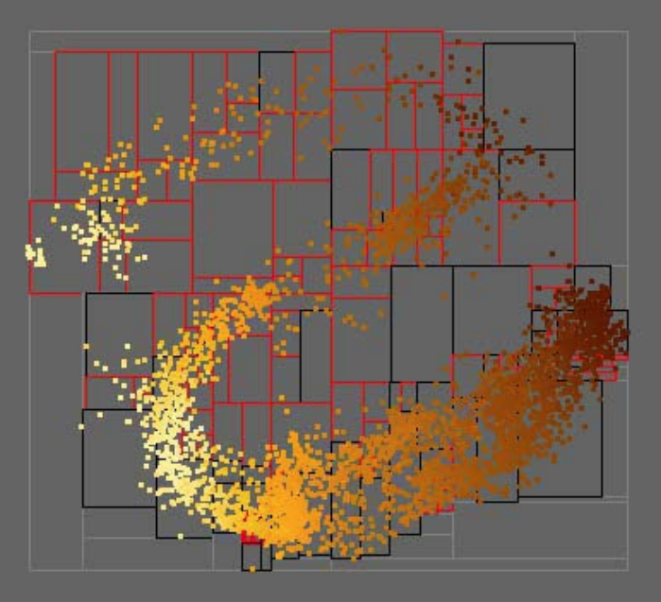
MDSteer (Williams & Munzner, 2004)
1 – Introduction
2.2 – Interaction in Progressive Visual Analytics
3 – Propositions
4 – Conclusion
Data
high-dimensional data
Algorithm
progressive Multidimensional Scaling (MDS)
Visualization
2D output embedding
Interactions
prioritize data points

Slide 14
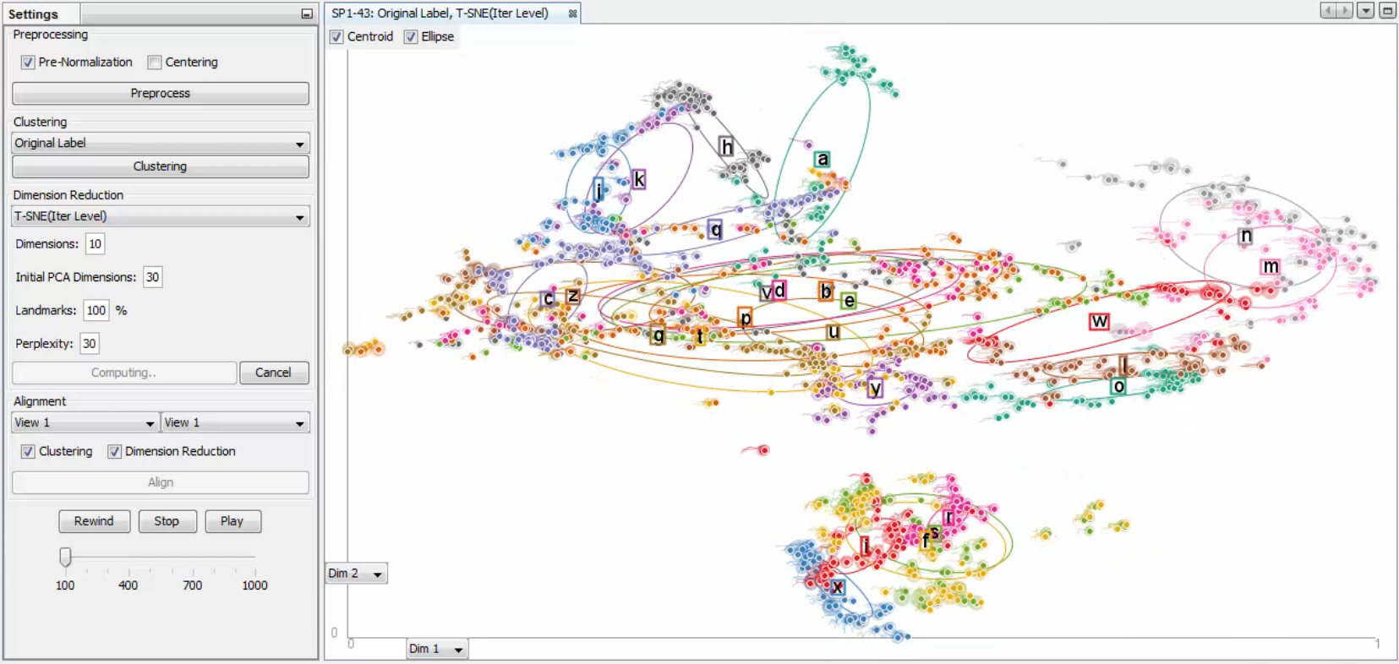
PIVE (Kim et al., 2017)
1 – Introduction
2.2 – Interaction in Progressive Visual Analytics
3 – Propositions
4 – Conclusion
Data
high-dimensional data
Algorithm
t-SNE
k-means
Visualization
2D output embedding
clusters
Interactions
update parameters
adjust the algorithm’s output

Slide 15
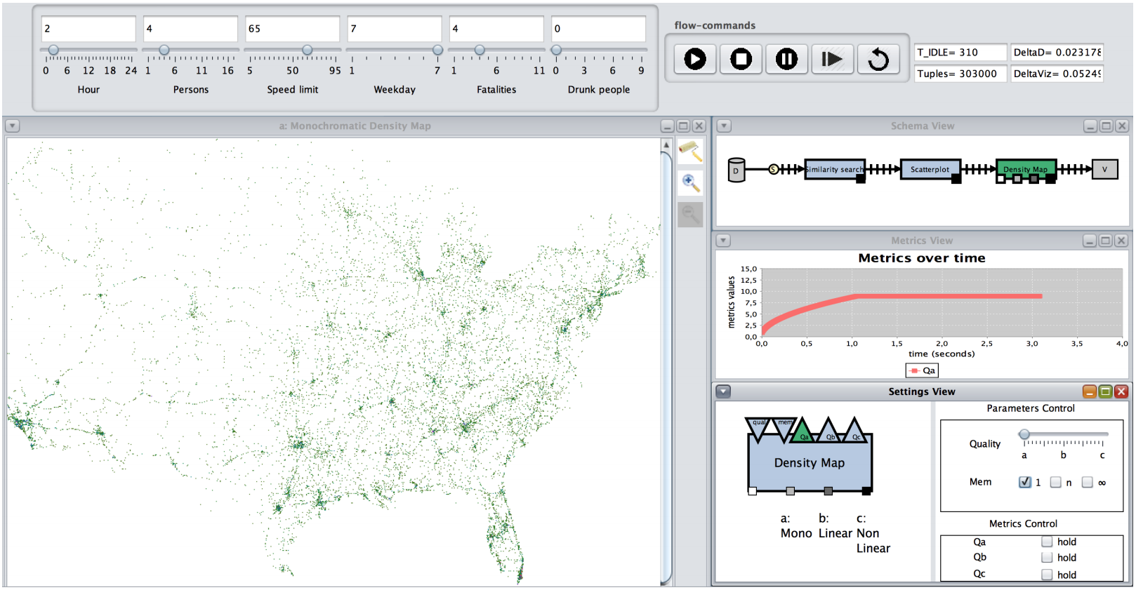
Similarity search (Schulz et al., 2016)
1 – Introduction
2.2 – Interaction in Progressive Visual Analytics
3 – Propositions
4 – Conclusion
Data
geospatial data
Algorithm
similarity search
Visualization
incremental geospatial representation of data points
algorithm process
Interactions
update search target
pause/resume/stop the computation
update parameters

Slide 16
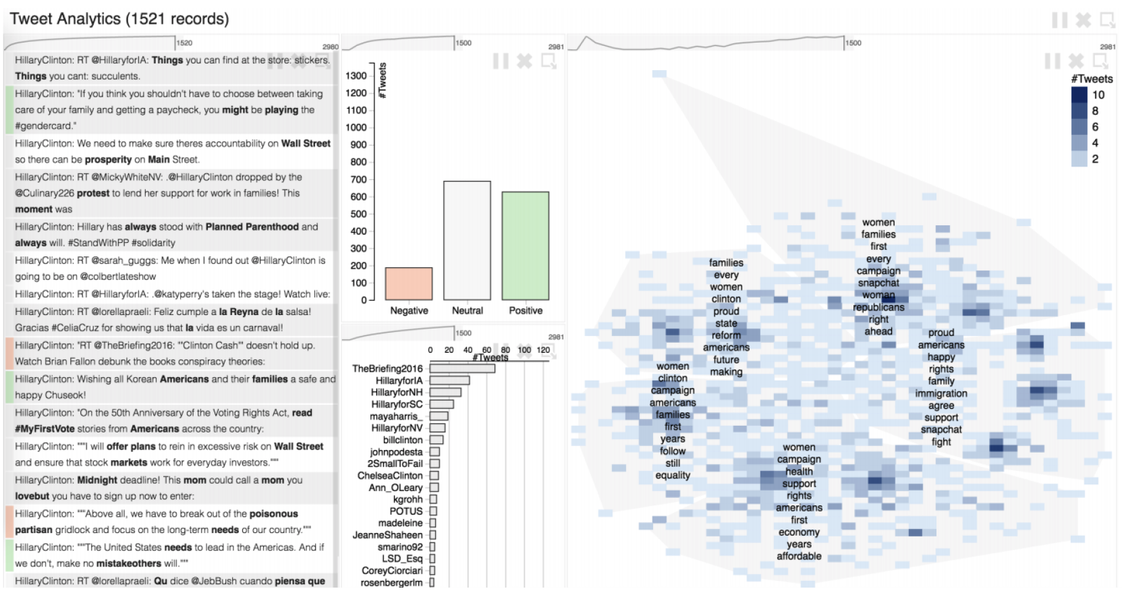
InsightsFeed (Badam et al., 2017)
1 – Introduction
2.2 – Interaction in Progressive Visual Analytics
3 – Propositions
4 – Conclusion
Data
tweets
Algorithm
sentiment extraction
t-SNE
k-means
Visualization
tweets’ content
progression of the process
2D output embedding
Interactions
pause/resume/stop the algorithm
update parameters

Slide 17
Outline
Related works
  From Visual Analytics to Progressive Visual Analytics
  Interaction in Progressive Visual Analytics
  Sequential Pattern Mining and Progressive Visual Analytics
Contributions
  Clarifying interaction in Progressive Visual Analytics
  Implementing Progressive Pattern Mining
  Evaluating the impact of progressiveness on analysis tasks
Conclusion and Discussion

Slide 18
Different interactions in existing systems…
1 – Introduction
2.2 – Interaction in Progressive Visual Analytics
3 – Propositions
4 – Conclusion
Adjust the algorithm’s output
Update parameters
Pause/resume/stop the computation
Prioritize data points
Update search target
Add/modify/remove data points
Update the algorithm’s strategy

Slide 19
… often called « steering »
1 – Introduction
2.2 – Interaction in Progressive Visual Analytics
3 – Propositions
4 – Conclusion
« steer the computation »
Williams and Munzner, 2004
Pezzotti et al., 2017
Badam et al., 2017
Challenge 1
Clarify what « interaction » and « steering » mean in the context of Progressive Visual Analytics
« steer the algorithm »
Kim et al., 2017
« steer the process »
Schulz et al., 2016
« steer computational resources »
Williams and Munzner, 2004

Slide 20
Studies have been conducted on the topic of interaction…
1 – Introduction
2.2 – Interaction in Progressive Visual Analytics
3 – Propositions
4 – Conclusion
Impact of incremental visualization on decision making and data exploration
[Fisher et al., 2012]
Progressive loading of large time series
[Glueck et al., 2014]
effective, allow for new exploration behaviors
allows for early exploration and accurate report of important insights
Comparison of the effect of blocking, progressive and instantaneous computations
[Zgraggen et al., 2017]
Sensemaking with classical and PVA tools, focus on how analysts build confidence when working with approximate answers
[Badam et al., 2017]
latency has a greater impact on brushing than on panning and zooming
users approach early results in very different ways
instantaneous and progressive visualizations lead to a similar number of insights
PVA does not lead to worse results than classical analysis techniques

Slide 21
… with a focus on interaction between the human and the visualization
1 – Introduction
2.2 – Interaction in Progressive Visual Analytics
3 – Propositions
4 – Conclusion
Impact of working with an updating visualization
interpretation of intermediate results
Challenge 2
Explore how interactions between the human and the algorithm affect the analysis process
management of uncertainty
Interaction between the human and the algorithm is unexplored

Slide 22
Outline
Related works
  From Visual Analytics to Progressive Visual Analytics
  Interaction in Progressive Visual Analytics
  Sequential Pattern Mining and Progressive Visual Analytics
Contributions
  Clarifying interaction in Progressive Visual Analytics
  Implementing Progressive Pattern Mining
  Evaluating the impact of progressiveness on analysis tasks
Conclusion and Discussion

Slide 23
Sequential Pattern Mining
1 – Introduction
2.3 – Sequential Pattern Mining and Progressive Visual Analytics
3 – Propositions
4 – Conclusion
Sequence: ordered list of events
Sequential pattern: A succession of event types (AB, BCA…)
repeating
Sequential pattern mining: Extracting repeating sequential patterns from a dataset
Support: Number of times a pattern is found in the data
Support of BCA
sequential pattern
episode
A
D
A
C
C
B
C
B
D
C
A
D
C
B
A
S₁
1
1
t₁
t₂
t₃
t₄
t₅
t₆
t₇
t₈
t₉
t₁₀
t₁₁
t₁₂
t₁₃
t₁₄
t₁₅
+
+
C
D
A
B
C
C
A
B
C
B
S₂
1
1
t₁
t₂
t₃
t₄
t₅
t₆
t₇
t₈
t₉
t₁₀
+
+
B
C
A
D
D
C
B
A
C
A
S₃
1
2
t₁
t₂
t₃
t₄
t₅
t₆
t₇
t₈
t₉
t₁₀
=
=
3
4

Slide 24
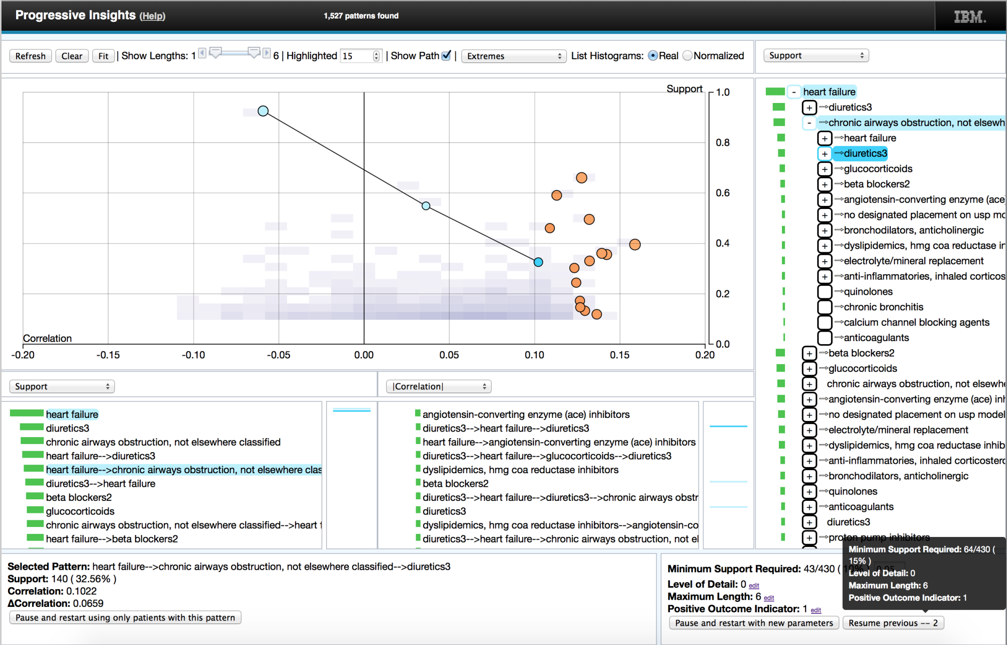
Sequential Pattern Mining in PVA (Stolper et al., 2014)
1 – Introduction
2.3 – Sequential Pattern Mining and Progressive Visual Analytics
3 – Propositions
4 – Conclusion
Data
sequential data
Algorithm
progressive SPAM
Visualization
lists of patterns
2D projection of patterns
Information about selected pattern
algorithm parameters
Interactions
prioritize search target
update parameters
remove data points

Slide 25
Limitations in Stolper et al.’s work: no information about data
1 – Introduction
2.3 – Sequential Pattern Mining and Progressive Visual Analytics
3 – Propositions
4 – Conclusion
No data visualization
data exploration replaced by pattern exploration
Challenge 3
Provide a progressive interface to explore data and patterns at the same time
Limited representation of patterns
focus on properties and statistical measures
no representation of occurrences

Slide 26
Limitations in Stolper et al.’s work: a case study more than a user study
1 – Introduction
2.3 – Sequential Pattern Mining and Progressive Visual Analytics
3 – Propositions
4 – Conclusion
Focus on the usefulness of Progressive Visual Analytics
benefits of having intermediate results
« hear insight-based stories of success from domain experts »
Challenge 4
Understand which interactions are relevant between a human and a progressive pattern mining algorithm
Pattern mining is not central to the study
no systematic exploration of interactions with a pattern mining algorithm
no controlled comparison between Visual Analytics and Progressive Visual Analytics

Slide 27
Four challenges to address
1 – Introduction
2.3 – Sequential Pattern Mining and Progressive Visual Analytics
3 – Propositions
4 – Conclusion
Progressive Visual Analytics
Challenge 1
Challenge 2
Clarify what « interaction » and « steering » mean in the context of Progressive Visual Analytics
Explore how interactions between the human and the algorithm affect the analysis process
Progressive Pattern Mining
Challenge 3
Challenge 4
Provide a progressive interface to explore data and patterns at the same time
Understand which interactions are relevant between a human and a progressive pattern mining algorithm

Slide 28
Outline
Related works
  From Visual Analytics to Progressive Visual Analytics
  Interaction in Progressive Visual Analytics
  Sequential Pattern Mining and Progressive Visual Analytics
Contributions
  Clarifying interaction in Progressive Visual Analytics
  Implementing Progressive Pattern Mining
  Evaluating the impact of progressiveness on analysis tasks
Conclusion and Discussion

Slide 29
Contr. 1: A framework of actions performed to interact with a PVA system
1 – Introduction
2 – Related Works
3.1 – Clarifying interaction in Progressive Visual Analytics
4 – Conclusion
Progressive Algorithm
Data
View
Explore
PVA system

Slide 30
Contr. 1: A framework of actions performed to interact with a PVA system
1 – Introduction
2 – Related Works
3.1 – Clarifying interaction in Progressive Visual Analytics
4 – Conclusion
Analyst’s actions
A1. Modify data
A1. Modify data
A2. Constrain algorithm on data
A3. Constrain algorithm on results
Progressive Algorithm
A4. Change parameters
Data
View
Explore
!
Data
updated
!
Execution
updated
!
View
updated
PVA system

Slide 31
Contr. 2.1: A definition of « steering »
1 – Introduction
2 – Related Works
3.1 – Clarifying interaction in Progressive Visual Analytics
4 – Conclusion
Badam et al.
(2017)
Kim et al.
(2017)
Pezzotti et al.
(2017)
Schulz et al.
(2016)
Stolper et al.
(2014)
Williams et al.
(2004)
A1. Modify data
Restart
✓
Restart
A2. Constrain algorithm on data
✓
✓
A3. Constrain algorithm on results
✓
✓
A4. Change parameters
Restart
Restart
Restart
Steering [an algorithm]:
the user expresses a constraint on a subset of the data or of the results
the algorithm satisfies the constraint without restarting

Slide 32
Contr. 2.2: A definition of Progressive Visual Analytics systems
1 – Introduction
2 – Related Works
3.1 – Clarifying interaction in Progressive Visual Analytics
4 – Conclusion
Data
Progressive Algorithm
View
Analyst’s actions
Analyst’s actions
A1. Modify data
A2. Constrain algorithm on data
A2. Constrain algorithm on data
A3. Constrain algorithm on results
A3. Constrain algorithm on results
A4. Change parameters
Explore
Progressive Visual Analytics system:
a progressive algorithm
a progressive visualization
interaction means for steering

Slide 33
Contr. 2.3: A model of the Progressive Visual Analytics workflow
1 – Introduction
2 – Related Works
3.1 – Clarifying interaction in Progressive Visual Analytics
4 – Conclusion
Evolution of the Visual Analytics model from Sacha et al. (2014)
Computer
Action
Visualization
Data
Human
observation
Model
observation
Findings
inspection

Slide 34
Contr. 2.3: A model of the Progressive Visual Analytics workflow
1 – Introduction
2 – Related Works
3.1 – Clarifying interaction in Progressive Visual Analytics
4 – Conclusion
Evolution of the Visual Analytics model from Sacha et al. (2014)
Computer
Action
A1. data
modification
A4. parameter change
Visualization
A2. constrain on data
A3. constrain on results
Data
Human
observation
Algorithm
Parameters
Model
Data
observation
Findings
observation
checking
inspection

Slide 35
Outline
Related works
  From Visual Analytics to Progressive Visual Analytics
  Interaction in Progressive Visual Analytics
  Sequential Pattern Mining and Progressive Visual Analytics
Contributions
  Clarifying interaction in Progressive Visual Analytics
    A framework of actions performed to interact with a PVA system
    An updated definition of Progressive Visual Analytics
      A definition of « steering »
      A definition of « PVA system »
      A model of the PVA workflow
  Implementing Progressive Pattern Mining
  Evaluating the impact of progressiveness on analysis tasks
Conclusion and Discussion

Slide 36
Outline
Related works
  From Visual Analytics to Progressive Visual Analytics
  Interaction in Progressive Visual Analytics
  Sequential Pattern Mining and Progressive Visual Analytics
Contributions
  Clarifying interaction in Progressive Visual Analytics
  Implementing Progressive Pattern Mining
  Evaluating the impact of progressiveness on analysis tasks
Conclusion and Discussion

Slide 37
Contr. 3: Five guidelines for Progressive Sequential Pattern Mining
1 – Introduction
2 – Related Works
3.2 – Implementing Progressive Pattern Mining
4 – Conclusion
G1
G1
Use episodes rather than sequential patterns
Use episodes rather than sequential patterns
G2
Save episodes’ occurrences
A
D
A
C
C
B
C
B
D
C
A
D
C
B
A
S₁
t₁
t₂
t₃
t₄
t₅
t₆
t₇
t₈
t₉
t₁₀
t₁₁
t₁₂
t₁₃
t₁₄
t₁₅
G3
Give the ability to steer on pattern, sequence and time
C
D
A
B
C
C
A
B
C
B
S₂
t₁
t₂
t₃
t₄
t₅
t₆
t₇
t₈
t₉
t₁₀
G4
Use a breadth-first apriori-like strategy
B
C
A
D
D
C
B
A
C
A
S₃
t₁
t₂
t₃
t₄
t₅
t₆
t₇
t₈
t₉
t₁₀
G5
Provide information about the current behavior with regards to steering

Slide 38

Contr. 3: Five guidelines for Progressive Sequential Pattern Mining
1 – Introduction
2 – Related Works
3.2 – Implementing Progressive Pattern Mining
4 – Conclusion
G1
Use episodes rather than sequential patterns
A
D
A
C
C
B
C
A
B
C
B
D
C
A
D
C
B
A
S₁
t₁
t₂
t₃
t₄
t₅
t₆
t₁₁
t₆
t₇
t₈
t₉
t₁₀
t₁₁
t₁₂
t₁₃
t₁₄
t₁₅
C
D
A
B
B
C
C
C
A
G2
Save episodes’ occurrences
A
B
C
B
G2
S₂
t₁
t₂
t₃
t₄
t₄
t₅
t₆
t₇
t₇
t₈
t₉
t₁₀
B
B
C
A
B
C
C
A
G3
Give the ability to steer on pattern, sequence and time
A
D
D
C
B
A
C
A
S₃
t₁
t₇
t₁₀
t₁
t₂
t₃
t₃
t₄
t₅
t₆
t₇
t₈
t₉
t₁₀
G4
Use a breadth-first apriori-like strategy
BCA:
S₁(t₆, t₁₁)
S₂(t₄, t₇)
S₃(t₁, t₃)
G5
Provide information about the current behavior with regards to steering
S₃(t₇, t₁₀)

Slide 39
Contr. 3: Five guidelines for Progressive Sequential Pattern Mining
1 – Introduction
2 – Related Works
3.2 – Implementing Progressive Pattern Mining
4 – Conclusion
G1
Use episodes rather than sequential patterns
G2
Save episodes’ occurrences
Data model [Andrienko & Andrienko, 2006]
Referrers
determine
Attributes
G3
Give the ability to steer on pattern, sequence and time
G4
Use a breadth-first apriori-like strategy
determine
Sequences
Pattern
occurrences
Patterns
G5
Timecodes
Provide information about the current behavior with regards to steering

Slide 40
Contr. 3: Five guidelines for Progressive Sequential Pattern Mining
1 – Introduction
2 – Related Works
3.2 – Implementing Progressive Pattern Mining
4 – Conclusion
G1
Use episodes rather than sequential patterns
Pattern-growth strategy
G2
Save episodes’ occurrences
Apriori-like strategy
Directly generate patterns
G3
Give the ability to steer on pattern, sequence and time
G4
Use a breadth-first apriori-like strategy
Depth-first
A
B
C
Breadth-first
AA
AB
AC
BA
BB
BC
G5
Provide information about the current behavior with regards to steering
AAA
AAB
ABA

Slide 41
Contr. 3: Five guidelines for Progressive Sequential Pattern Mining
1 – Introduction
2 – Related Works
3.2 – Implementing Progressive Pattern Mining
4 – Conclusion
G1
Use episodes rather than sequential patterns
Pattern space
Pattern size
Default behavior
1
G2
Save episodes’ occurrences
2
3
G3
Give the ability to steer on pattern, sequence and time
4
5
G4
Use a breadth-first apriori-like strategy
6
7
G5
8
Provide information about the current behavior with regards to steering

Slide 42
Contr. 3: Five guidelines for Progressive Sequential Pattern Mining
1 – Introduction
2 – Related Works
3.2 – Implementing Progressive Pattern Mining
4 – Conclusion
G1
Use episodes rather than sequential patterns
Pattern space
Pattern size
Default behavior
1
G2
Save episodes’ occurrences
Steering behavior
2
3
G3
Give the ability to steer on pattern, sequence and time
4
5
G4
Use a breadth-first apriori-like strategy
6
7
G5
8
Provide information about the current behavior with regards to steering

Slide 43
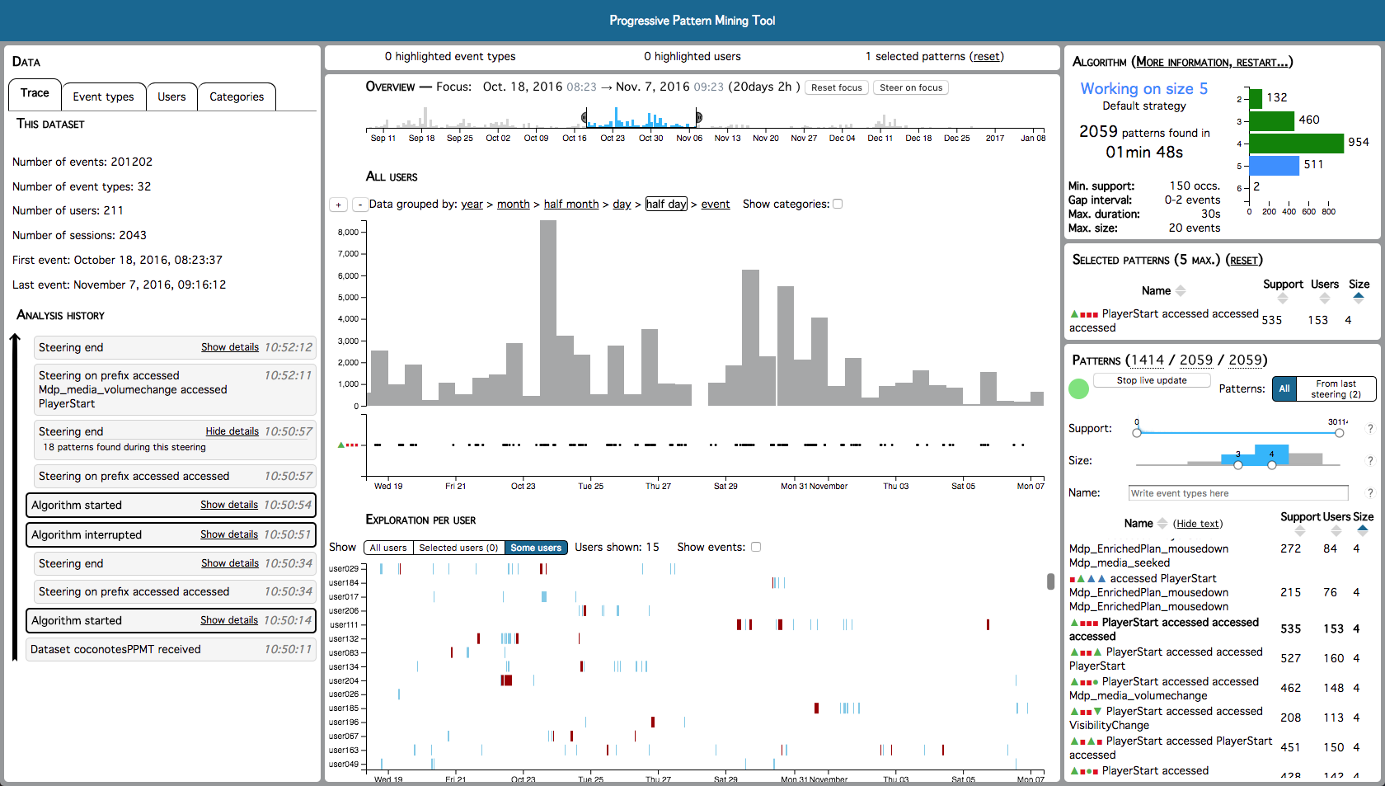
Contr. 4: A tool for progressive pattern mining
1 – Introduction
2 – Related Works
3.2 – Implementing Progressive Pattern Mining
4 – Conclusion
Follows our guidelines
G1. Use episodes rather than sequential
patterns
G2. Save episodes’ occurrences
G3. Give the ability to steer on pattern,
sequence and time
G4. Use a breadth-first Apriori-like strategy
G5. Provide information about the current
behavior with regards to steering
PPMT (Progressive Pattern Mining Tool)
Implements our actions
web-based
A1. Modify data
A2. Constrain algorithm on data
client-server
A3. Constrain algorithm on results
A4. Change parameters

Slide 44
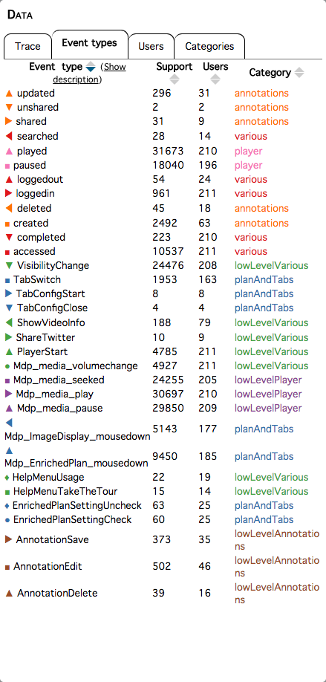
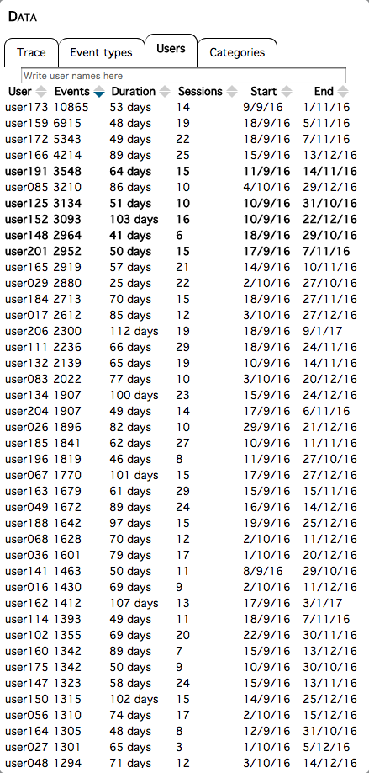
PPMT’s user interface
1 – Introduction
2 – Related Works
3.2 – Implementing Progressive Pattern Mining
4 – Conclusion

Slide 45
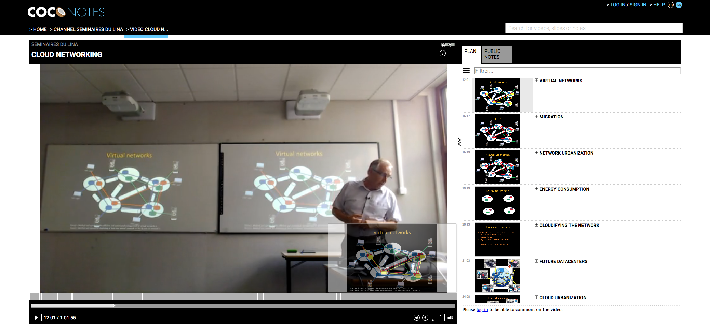
The COCoNotes dataset
1 – Introduction
2 – Related Works
3.2 – Implementing Progressive Pattern Mining
4 – Conclusion
Video annotation platform activity
September 2016 to January 2017
211 users
201 000 events, 32 event types
login
selectVideo
play
addAnnotation
pause
…

Slide 46
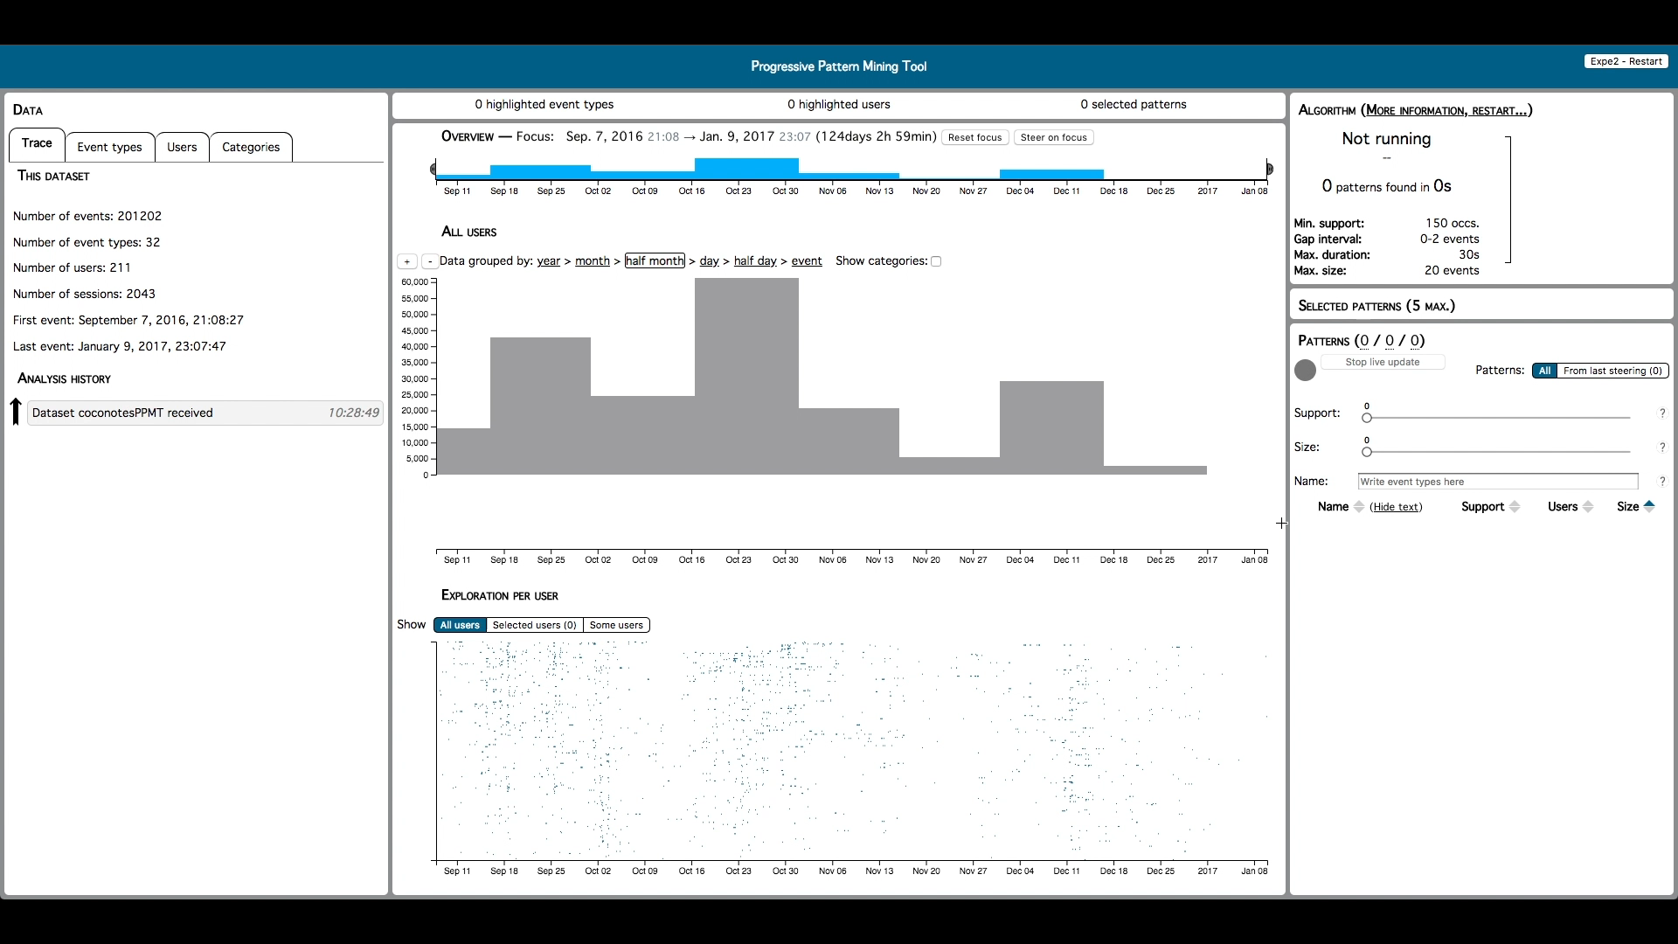
Using PPMT
1 – Introduction
2 – Related Works
3.2 – Implementing Progressive Pattern Mining
4 – Conclusion

Slide 47
Outline
Related works
  From Visual Analytics to Progressive Visual Analytics
  Interaction in Progressive Visual Analytics
  Sequential Pattern Mining and Progressive Visual Analytics
Contributions
  Clarifying interaction in Progressive Visual Analytics
  Implementing Progressive Pattern Mining
  Evaluating the impact of progressiveness on analysis tasks
Conclusion and Discussion

Slide 48
Contr. 5: A user study using our progressive tool
1 – Introduction
2 – Related Works
3.3 – Evaluating the impact of progressiveness on analysis tasks
4 – Conclusion
Objective: Study interaction between a human and a progressive algorithm
A: How does interaction with the algorithm impact the analysis process?
answer time, correctness of the results
hypothesis 1: steering leads to faster answers
hypothesis 2: correctness of results should not depend on steering
B: How are the different interactions perceived by the analysts?
usefulness, intuitiveness
hypothesis 3: steering helps feeling in control of the algorithm
hypothesis 4: modifying the data contributes to find useful patterns

Slide 49

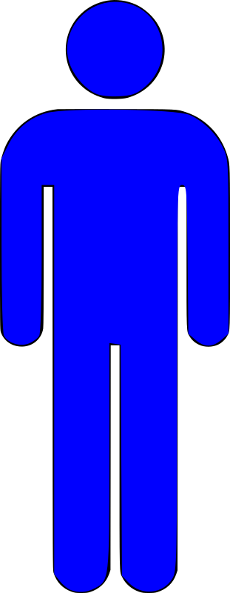
Two experimental conditions
1 – Introduction
2 – Related Works
3.3 – Evaluating the impact of progressiveness on analysis tasks
4 – Conclusion
non-steering group
(n=12)
steering group
(n=11)
not allowed to steer the computation
allowed to steer the computation
How many occurrences of the pattern « paused played VisibilityChange » are present in the data?
Presentation:
dataset
PPMT
Q1
Q2
Q3
Q4
Q5
Presentation:
Modify data
Q6
Q7
Q8
survey
Interview
How many patterns are discovered for user user049 for the 9:02am to 9:11am session on October 5?
Tasks achievable by both groups in reasonable time
Data collected:
Changing parameters was not available
answer time
answer correctness
use of available actions
survey results
interview comments

Slide 50
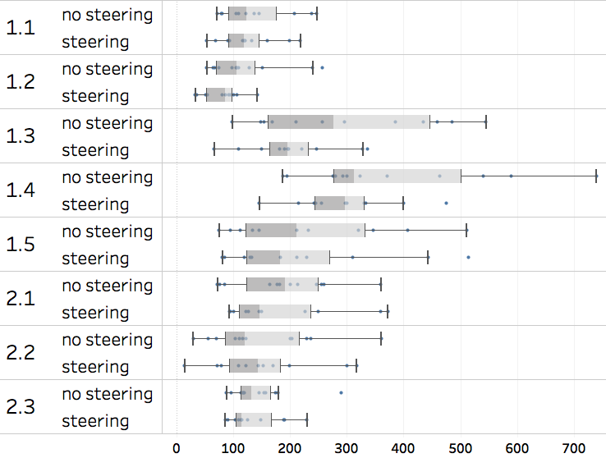
A: How does interaction with the algorithm impact the analysis process?
1 – Introduction
2 – Related Works
3.3 – Evaluating the impact of progressiveness on analysis tasks
4 – Conclusion
Time to answer
Q1
Q2
*
Steering group is faster for 7/8 questions
Q3
Q7 mostly wrong for non-steering group
*
Q4
few statistical significance
Q5
Q6
Hypothesis 1: steering leads to faster answers
Q7
✓
Q8
Answer time (s). indicate statisticaly significant results
*

Slide 51
A: How does interaction with the algorithm impact the analysis process?
1 – Introduction
2 – Related Works
3.3 – Evaluating the impact of progressiveness on analysis tasks
4 – Conclusion
Correctness of answers
How many patterns are discovered for user user049 in his first session on October 2nd (from 12:14 to 14:03)?
non-steering group
steering group
Q1
Q2
Q3
Q4
Q5
Q6
Q7
Q8
steering group slightly more correct
Remark about Q7:
no statistical significance
non-steering group: estimates to avoid waiting
maybe steering can help avoid wrong results, even if it does not bring better ones
Hypothesis 2: correctness of results should not depend on steering
?

Slide 52
B: How are the different interactions perceived by the analysts?
1 – Introduction
2 – Related Works
3.3 – Evaluating the impact of progressiveness on analysis tasks
4 – Conclusion
Use of actions
Group
Action
Q1
Q2
Q3
Q4
Q5
Q6
Q7
Q8
TOTAL
Non-steering
Modify data
2
0
4
6
Modify data
2
0
6
6
Steering
Steering
6
7
7
6
8
18
8
6
66
Steering is used a lot
Modify data is barely used
at least once for each participant
most participants never used it
once per question for several participants
similar use within both groups

Slide 53
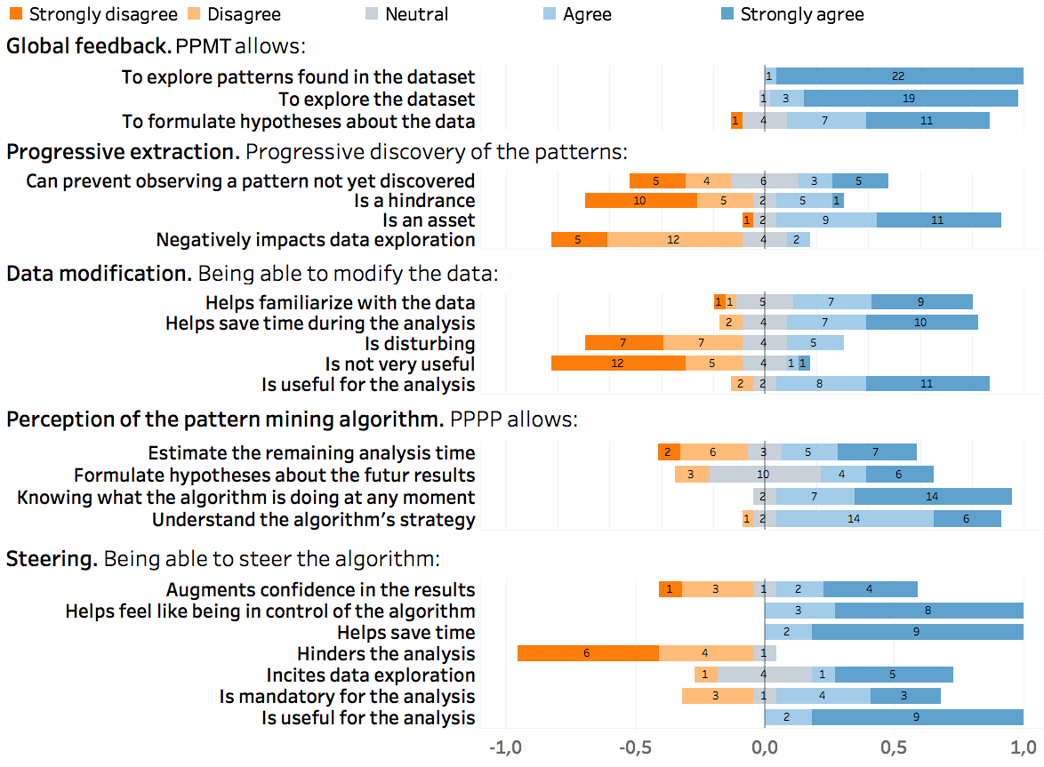
B: How are the different interactions perceived by the analysts?
1 – Introduction
2 – Related Works
3.3 – Evaluating the impact of progressiveness on analysis tasks
4 – Conclusion
Usefulness and intuitiveness of steering
Being able to steer the algorithm:
Augments confidence in the results
Helps feel in control of the algorithm
Helps save time
Hinders the analysis
Incites data exploration
Is mandatory for the analysis
Is useful for the analysis
Strongly disagree
Disagree
Neutral
Agree
Strongly agree
Steering felt useful
Steering was easily understood
helps saving time and feeling in control of the algorithm
no hesitation to use steering
relevant steering uses
« Without [steering], intermediate results would be way less useful »
« [steering] felt necessary »
Hypothesis 3: steering helps feeling in control of the algorithm
✓

Slide 54
B: How are the different interactions perceived by the analysts?
1 – Introduction
2 – Related Works
3.3 – Evaluating the impact of progressiveness on analysis tasks
4 – Conclusion
Usefulness and intuitiveness of modifying data
Being able to modify the data:
Helps familiarize with the data
Helps save time udring the analysis
Is disturbing
Is not very useful
Is useful for the analysis
Strongly disagree
Disagree
Neutral
Agree
Strongly agree
Modifying the data is considered useful
In practice, modifying the data is problematic
helps saving time and familiarizing with the data
uncertainty on time efficiency
fear of losing information in the process
« I wasn’t sure about the benefits [of modifying the data] »
« Will [it] be better or will I lose time recomputing previous patterns? »
Hypothesis 4: modifying the data contributes to find useful patterns
?

Slide 55
Conclusion from our experiment
1 – Introduction
2 – Related Works
3.3 – Evaluating the impact of progressiveness on analysis tasks
4 – Conclusion
A: How does interaction with the algorithm impact the analysis process?
✓
hypothesis 1: steering leads to faster answers
?
hypothesis 2: correctness of results should not depend on steering
B: How are the different interactions perceived by the analysts?
hypothesis 3: steering helps feeling in control of the algorithm
✓
hypothesis 4: modifying the data contributes to find useful patterns
?

Slide 56
Outline
Related works
  From Visual Analytics to Progressive Visual Analytics
  Interaction in Progressive Visual Analytics
  Sequential Pattern Mining and Progressive Visual Analytics
Contributions
  Clarifying interaction in Progressive Visual Analytics
  Implementing Progressive Pattern Mining
  Evaluating the impact of progressiveness on analysis tasks
Conclusion and Discussion

Slide 57
Conclusion
1 – Introduction
2 – Related Works
3 – Propositions
4 – Conclusion
Four challenges
Clarify what « interaction » and « steering » mean in the context of Progressive Visual Analytics
Explore how interactions between the human and the algorithm affect the analysis process
Provide a progressive interface to explore data and patterns at the same time
Understand which interactions are relevant between a human and a progressive pattern mining algorithm

Slide 58
Conclusion
1 – Introduction
2 – Related Works
3 – Propositions
4 – Conclusion
Four challenges
Six contributions
Clarify what « interaction » and « steering » mean in the context of Progressive Visual Analytics
An updated definition of Progressive Visual Analytics
– A definition of « steering »
– A definition of Progressive Visual Analytics systems
– A model of the Progressive Visual Analytics workflow
Explore how interactions between the human and the algorithm affect the analysis process
A framework of actions performed to interact with a PVA system
Provide a progressive interface to explore data and patterns at the same time
A user study on interaction between a human and a progressive algorithm
Five guidelines for Progressive Sequential Pattern Mining
Understand which interactions are relevant between a human and a progressive pattern mining algorithm
A tool for progressive pattern mining
A model of the tasks performed to explore temporal data with patterns

Slide 59
Limitations
1 – Introduction
2 – Related Works
3 – Propositions
4 – Conclusion
PPMT’s design led primarily by our framework and guidelines
implicating more real-world users in the design process could have led to different decisions
A controlled user study
focus on the use of the available interactions to perform a given task
no evaluation of PPMT’s ability to support an exploratory analysis
Evaluating Progressive Visual Analytics is a difficult task
requires many experts working on the same data

Slide 60
Perspectives
1 – Introduction
2 – Related Works
3 – Propositions
4 – Conclusion
Create natively progressive algorithms
our guidelines are a first step for Progressive Pattern Mining
explore progressive applications of « changing the parameters »
Apply our framework to other algorithms
how does it fare outside of sequential pattern mining?
are other actions possible?
Provide assistance to the analyst interacting with an algorithm
leverage our framework of actions
particularly useful for « modifying the data »
recent work focused on identifying types of PVA users (Micallef et al., 2019)

Slide 61
Thank you for your attention

Slide 62
Design choices in PPMT
Browser-based interface
Client-server architecture
Focus on interactions rather than visualization
Adapt an existing pattern mining algorithm
Communicate frequent patterns when all occurrences are discovered
Extract every occurrence, even during a steering
Storing frequent patterns and their occurrences on the server

Slide 63
Steering on time

Slide 64
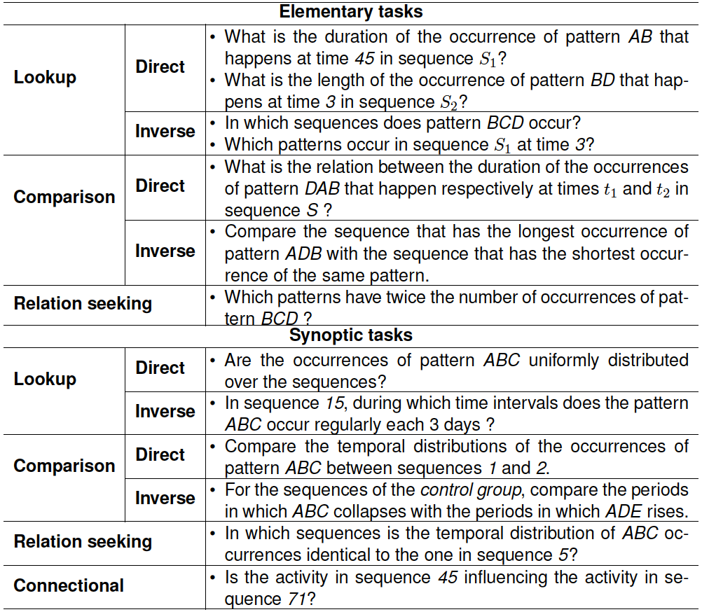
Example tasks with patterns

Slide 65
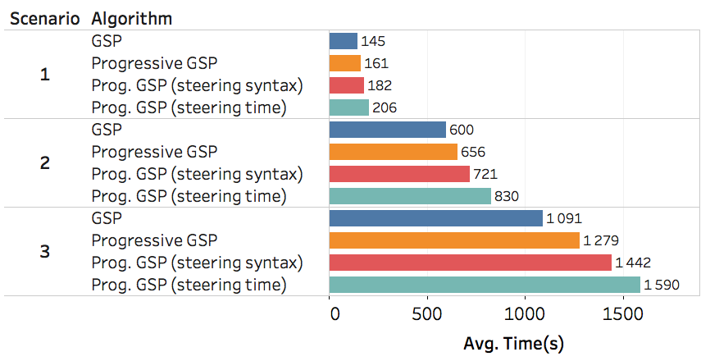
PPMT’s computation time
minGap = 0, maxGap = 2, maxSize = 20, maxDuration = 30s
minSupp = 150 (3492 frequent patterns)
minSupp = 50 (21731 frequent patterns)
minSupp = 30 (49121 frequent patterns)

Slide 66
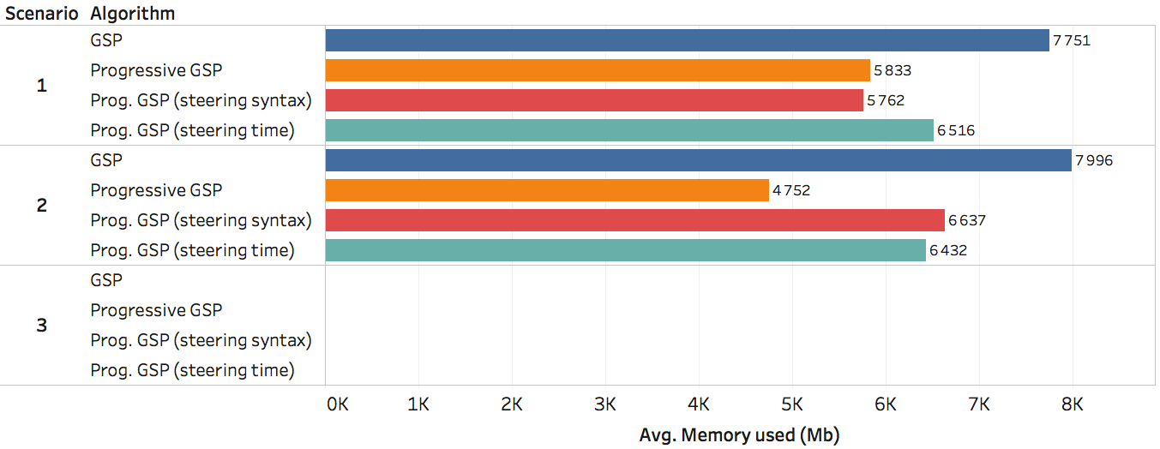
PPMT’s memory use
minGap = 0, maxGap = 2, maxSize = 20, maxDuration = 30s
minSupp=150
(3492 freq. patterns)
minSupp = 50 (21731 freq. patterns)
minSupp = 30 (49121 freq. patterns)

Slide 67
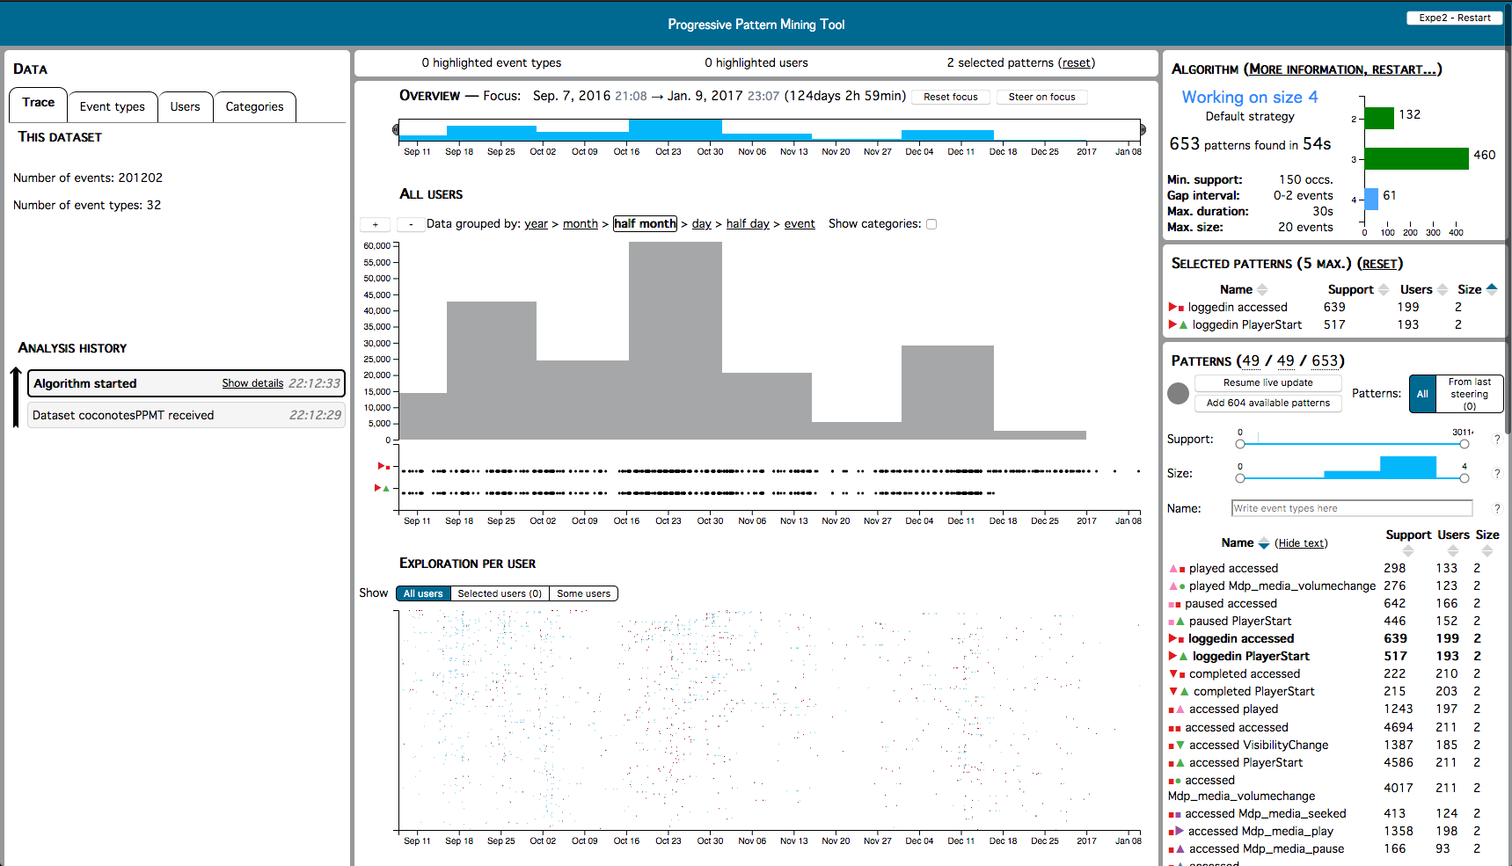
Comparing distributions with PPMT
Notes:
Illustration d’une tâche synoptique faite via l’interface de PPMT

Slide 68
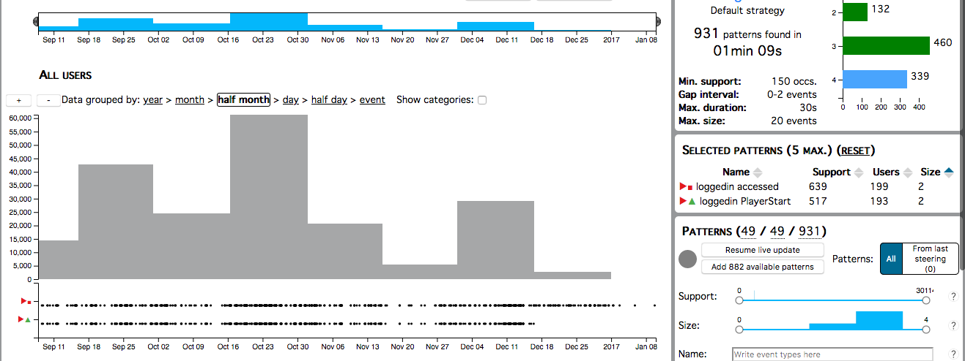
Comparing distributions with PPMT (zoomed in)
Notes:
Illustration d’une tâche synoptique faite via l’interface de PPMT

Slide 69
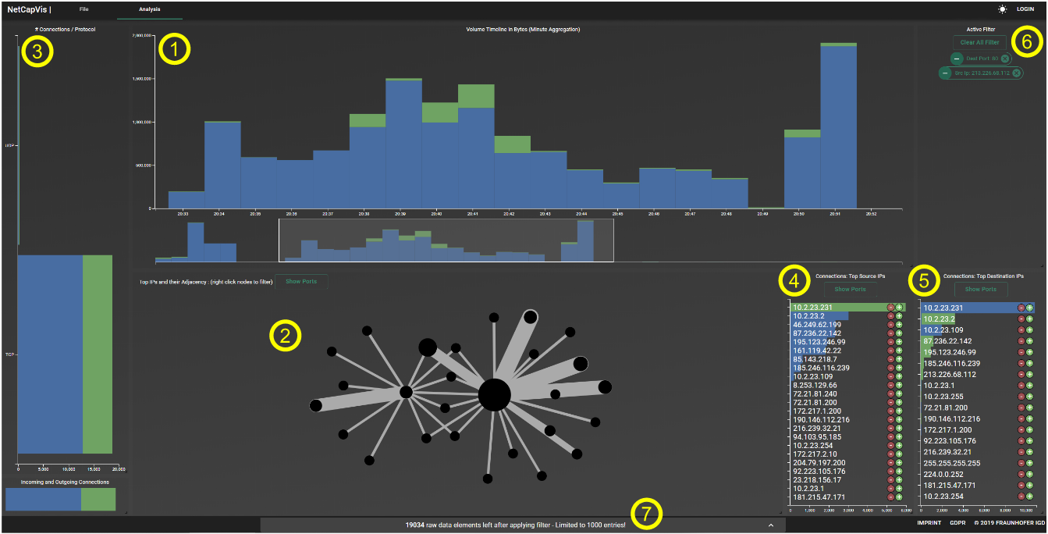
PVA system – NetCapVis (Ulmer et al., 2019)
Data
Network packets
Algorithm
aggregation
Visualization
timelines
barcharts
Interactions
prioritize data points

Slide 70
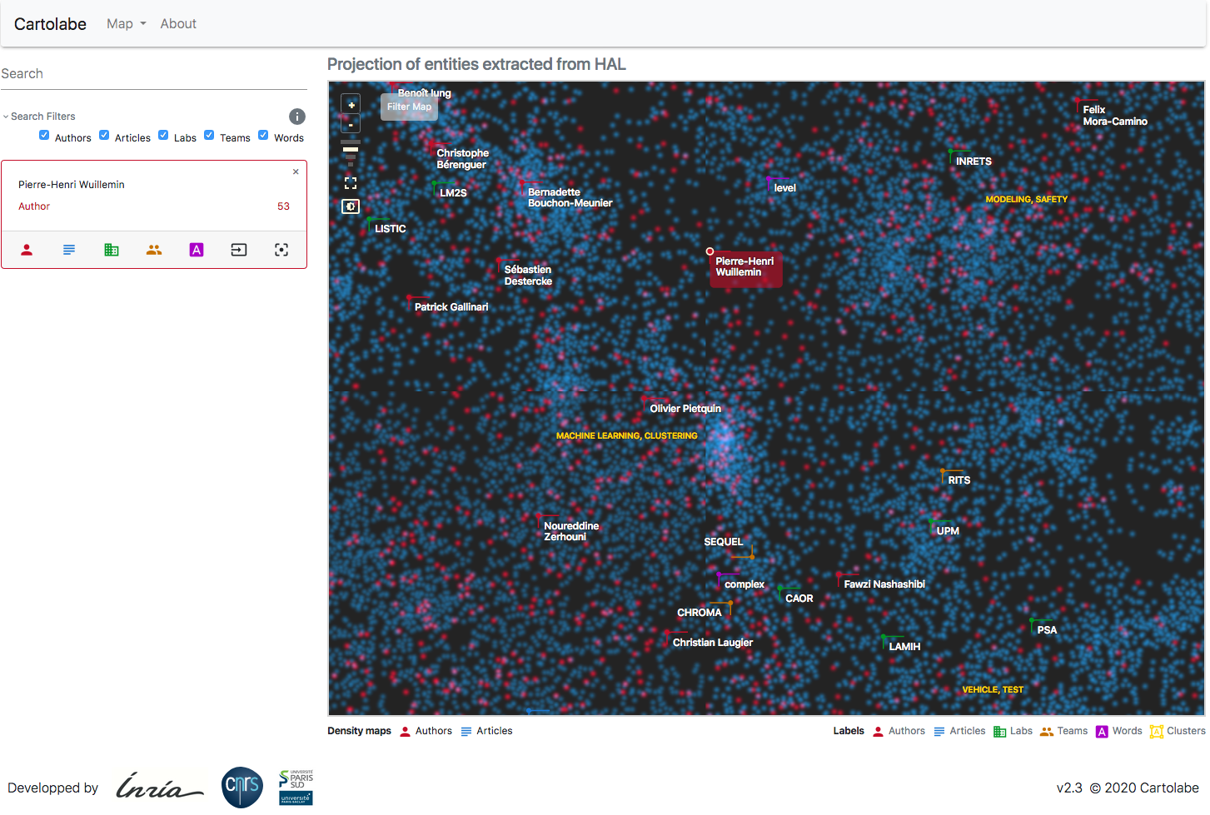
PVA system – CARTOLABE (Caillou et al., 2020)
Data
document collections
Algorithm
multidimensional projection (UMAP)
Visualization
density map
Interactions
prioritize data points

Slide 71
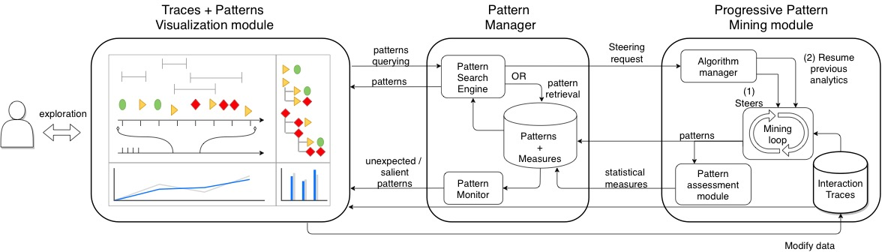
Theoretical architecture for progressive pattern mining

Slide 72
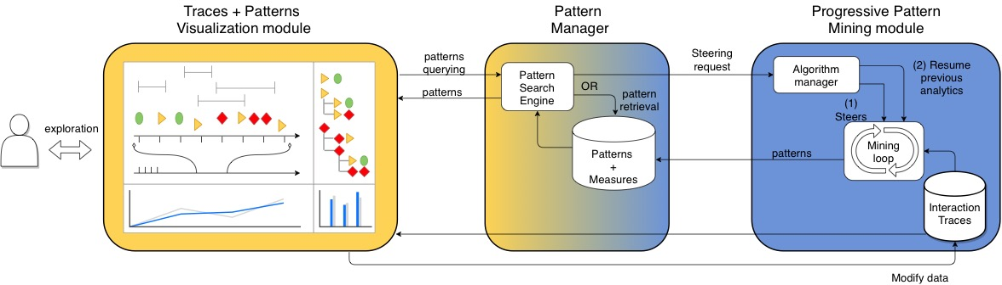
PPMT’s architecture

Slide 73
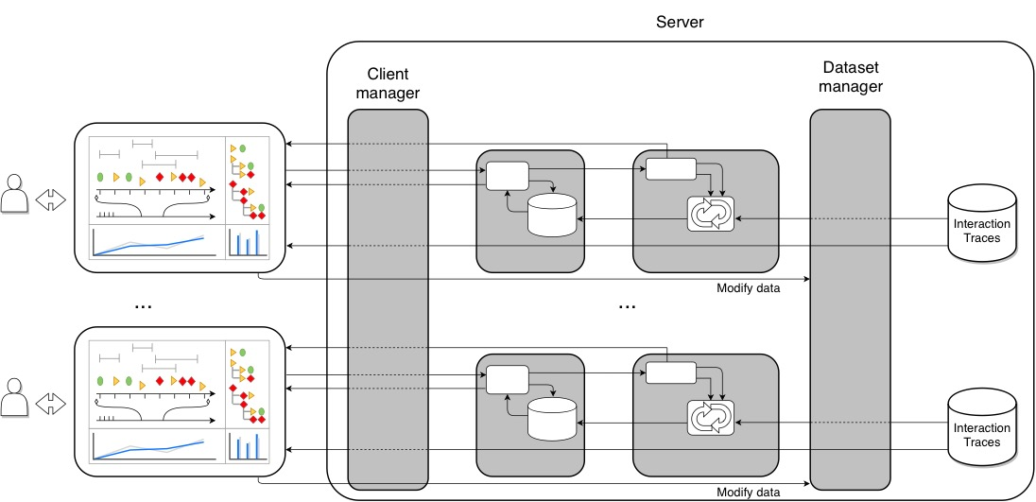
PPMT’s server architecture

Slide 74
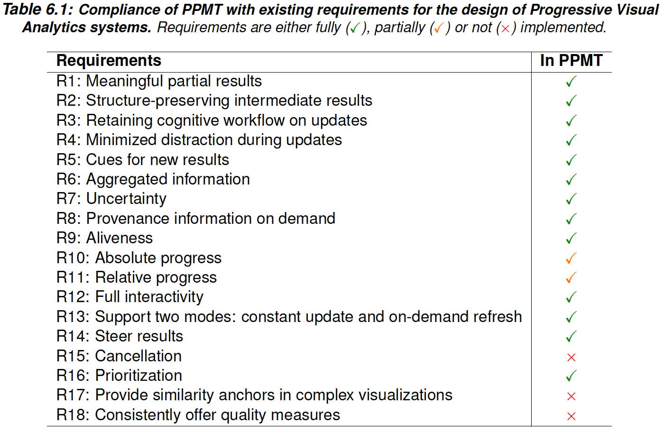
Compliance of PPMT with requirements for PVA systems

Slide 75
Questions from the user study
Q1
How many occurrences of the pattern “paused played VisibilityChange” are present in the data?
Q2
How many users have the pattern “paused created played” in their traces?
Q3
How many patterns are discovered for user user049 for the 9:02 to 9:11am session of October 5th?
Q4
Give two patterns with size > 2, present both in the first session of user user153 and in the first session of user user177 (September 18th, from 9:38am to 11:15am).
Q5
We are interested in the events “X” that can follow or precede the pattern M = “Mdp_media_play played”. How many “X M” or “M X” patterns are there?
Q6
How many occurrences of the pattern “paused played Mdp_media_pause paused” are present in the data?
Q7
How many patterns are discovered for user user049 in his first session on October 2nd (from 12:14 to 14:03)?
Q8
We are interested in the events “X” that can follow or precede the pattern M = “PlayerStart Mdp_media_volumechange”. How many “X M” or “M X” are there?

